Slide 1
CNN
These are the network parameters to be learned.
1 | -1 | -1
-1 | 1 | -1
-1 | -1 | 1
1 | 0 | 0 | 0 | 0 | 1
0 | 1 | 0 | 0 | 1 | 0
0 | 0 | 1 | 1 | 0 | 0
1 | 0 | 0 | 0 | 1 | 0
0 | 1 | 0 | 0 | 1 | 0
0 | 0 | 1 | 0 | 1 | 0
Filter 1
-1 | 1 | -1
-1 | 1 | -1
-1 | 1 | -1
Filter 2
……
6 x 6 image
Each filter detects a small pattern (3 x 3).

Slide 2
Convolution
1 | -1 | -1
-1 | 1 | -1
-1 | -1 | 1
Filter 1
stride=1
1 | 0 | 0 | 0 | 0 | 1
0 | 1 | 0 | 0 | 1 | 0
0 | 0 | 1 | 1 | 0 | 0
1 | 0 | 0 | 0 | 1 | 0
0 | 1 | 0 | 0 | 1 | 0
0 | 0 | 1 | 0 | 1 | 0
Dot
product
3
-1
6 x 6 image

Slide 3
Convolution
1 | -1 | -1
-1 | 1 | -1
-1 | -1 | 1
Filter 1
If stride=2
1 | 0 | 0 | 0 | 0 | 1
0 | 1 | 0 | 0 | 1 | 0
0 | 0 | 1 | 1 | 0 | 0
1 | 0 | 0 | 0 | 1 | 0
0 | 1 | 0 | 0 | 1 | 0
0 | 0 | 1 | 0 | 1 | 0
3
-3
6 x 6 image

Slide 4
Convolution
1 | -1 | -1
-1 | 1 | -1
-1 | -1 | 1
Filter 1
stride=1
1 | 0 | 0 | 0 | 0 | 1
0 | 1 | 0 | 0 | 1 | 0
0 | 0 | 1 | 1 | 0 | 0
1 | 0 | 0 | 0 | 1 | 0
0 | 1 | 0 | 0 | 1 | 0
0 | 0 | 1 | 0 | 1 | 0
3
-1
-3
-1
-3
1
0
-3
-3
-3
0
1
3
-2
-2
-1
6 x 6 image

Slide 5
Convolution
-1 | 1 | -1
-1 | 1 | -1
-1 | 1 | -1
Filter 2
stride=1
Repeat this for each filter
1 | 0 | 0 | 0 | 0 | 1
0 | 1 | 0 | 0 | 1 | 0
0 | 0 | 1 | 1 | 0 | 0
1 | 0 | 0 | 0 | 1 | 0
0 | 1 | 0 | 0 | 1 | 0
0 | 0 | 1 | 0 | 1 | 0
3
-1
-3
-1
-1
-1
-1
-1
-3
1
0
-3
-1
-1
-2
1
Feature
Map
-3
-3
0
1
-1
-1
-2
1
3
-2
-2
-1
6 x 6 image
-1
0
-4
3
Two 4 x 4 images
Forming 2 x 4 x 4 matrix

Slide 6
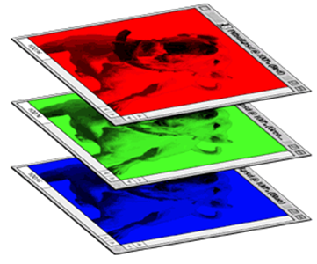
Color image: RGB 3 channels
1 | -1 | -1
-1 | 1 | -1
-1 | -1 | 1
-1 | 1 | -1
-1 | 1 | -1
-1 | 1 | -1
1 | -1 | -1
-1 | 1 | -1
-1 | -1 | 1
-1 | 1 | -1
-1 | 1 | -1
-1 | 1 | -1
1 | -1 | -1
-1 | 1 | -1
-1 | -1 | 1
-1 | 1 | -1
-1 | 1 | -1
-1 | 1 | -1
Filter 1
Filter 2
Color image
1 | 0 | 0 | 0 | 0 | 1
0 | 1 | 0 | 0 | 1 | 0
0 | 0 | 1 | 1 | 0 | 0
1 | 0 | 0 | 0 | 1 | 0
0 | 1 | 0 | 0 | 1 | 0
0 | 0 | 1 | 0 | 1 | 0
1 | 0 | 0 | 0 | 0 | 1
0 | 1 | 0 | 0 | 1 | 0
0 | 0 | 1 | 1 | 0 | 0
1 | 0 | 0 | 0 | 1 | 0
0 | 1 | 0 | 0 | 1 | 0
0 | 0 | 1 | 0 | 1 | 0
1 | 0 | 0 | 0 | 0 | 1
0 | 1 | 0 | 0 | 1 | 0
0 | 0 | 1 | 1 | 0 | 0
1 | 0 | 0 | 0 | 1 | 0
0 | 1 | 0 | 0 | 1 | 0
0 | 0 | 1 | 0 | 1 | 0

Slide 7
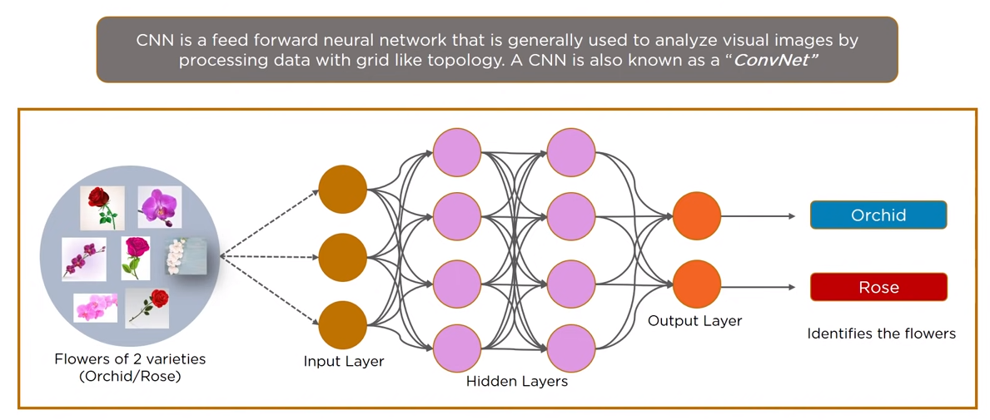
What is CNN?

Slide 8
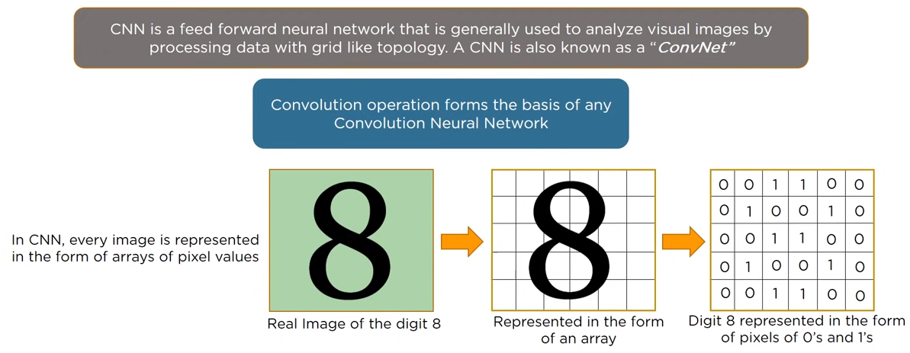
What is CNN?

Slide 9
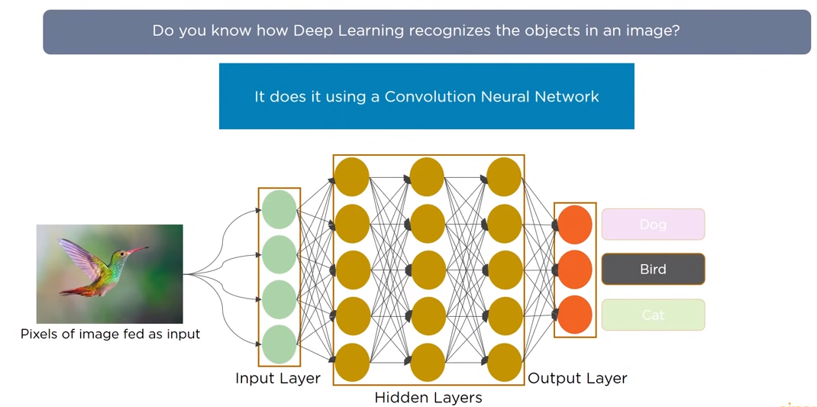
Illustration of CNN with an Example

Slide 10
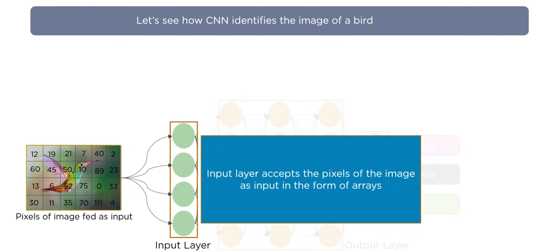
Image Identification Using CNN

Slide 11
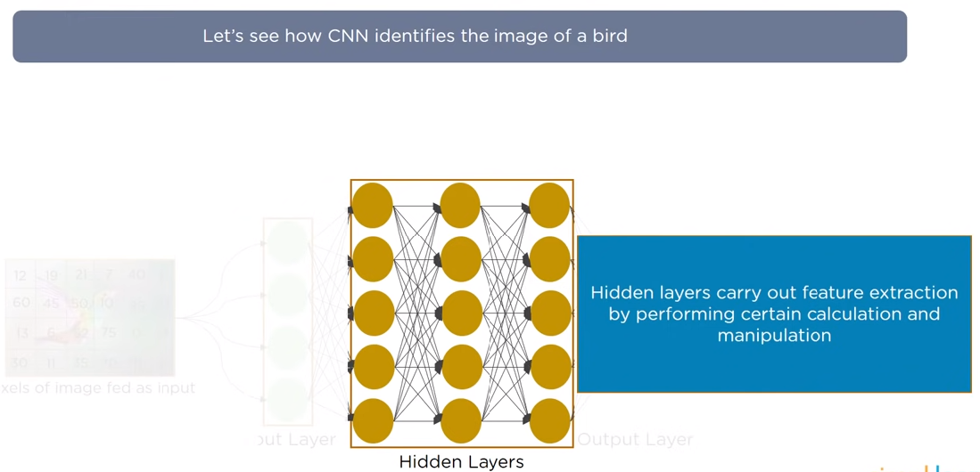
Image Identification Using CNN (2)

Slide 12
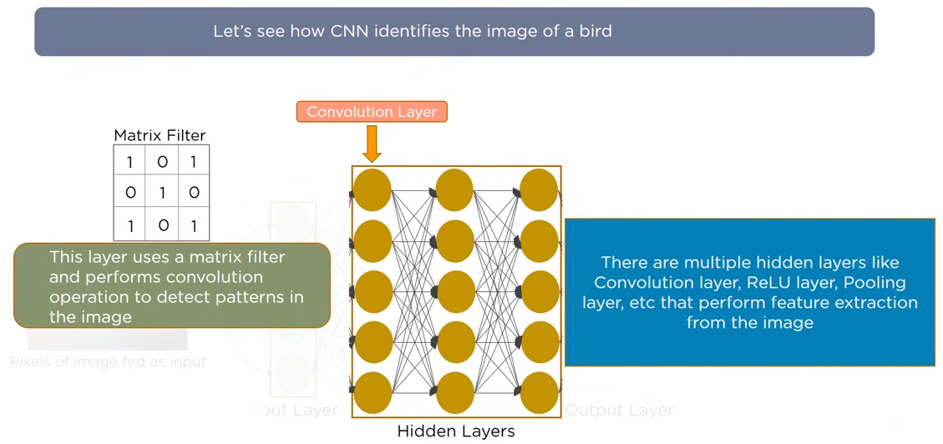
Image Identification Using CNN (3)

Slide 13
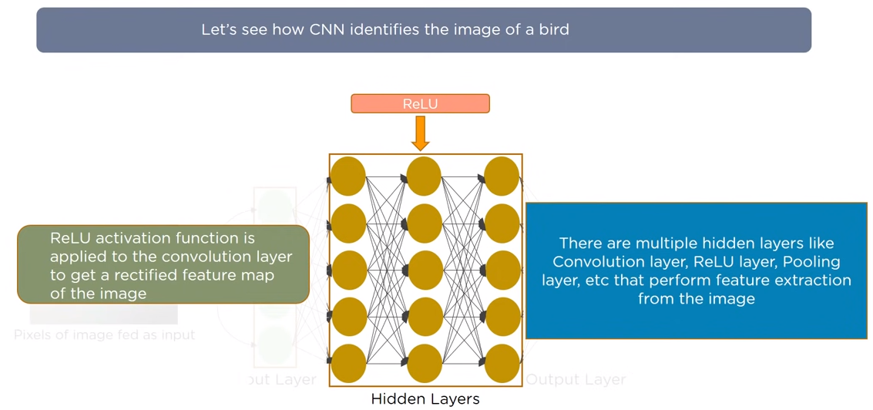
Image Identification Using CNN (4)

Slide 14
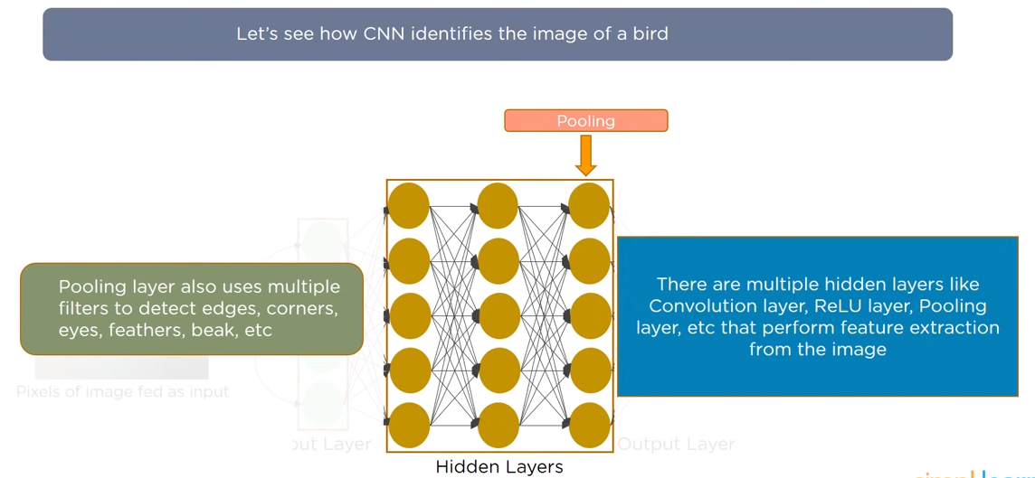
Image Identification Using CNN (5)

Slide 15
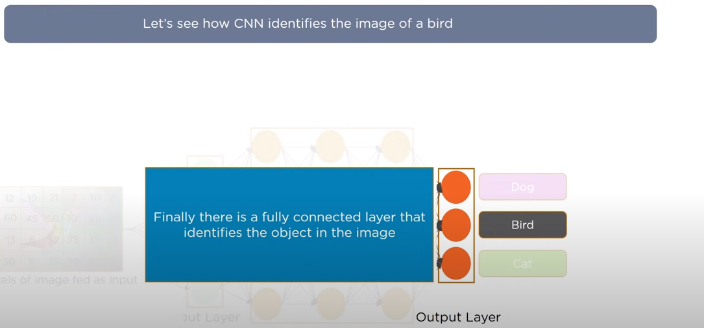
Image Identification Using CNN (6)

Slide 16
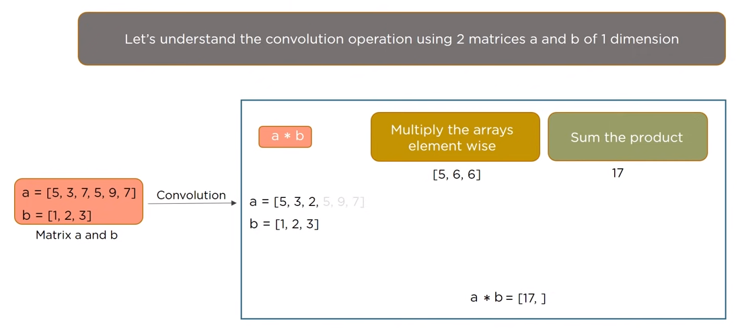
Understanding CNN

Slide 17
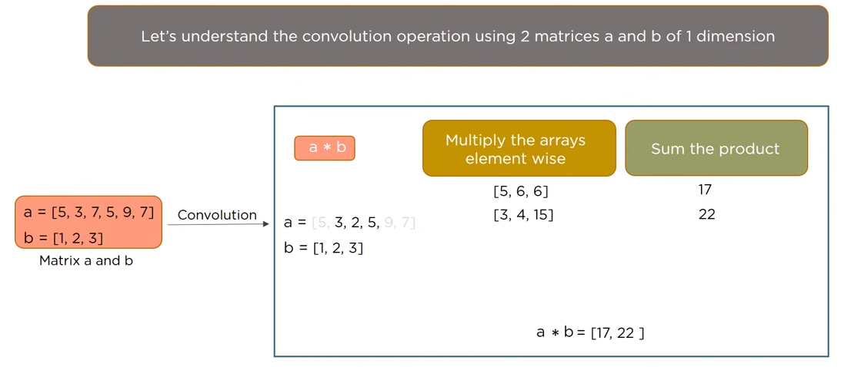
Understanding CNN (2)

Slide 18
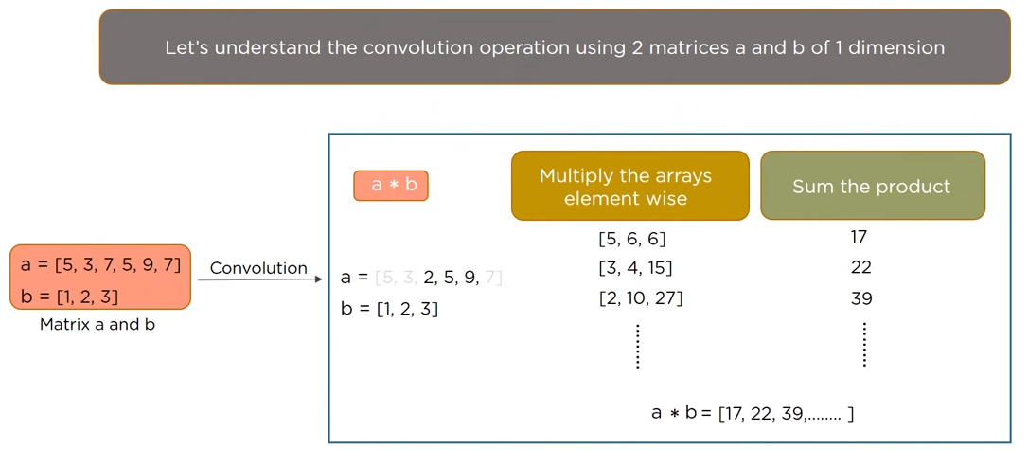
Understanding CNN (3)

Slide 19
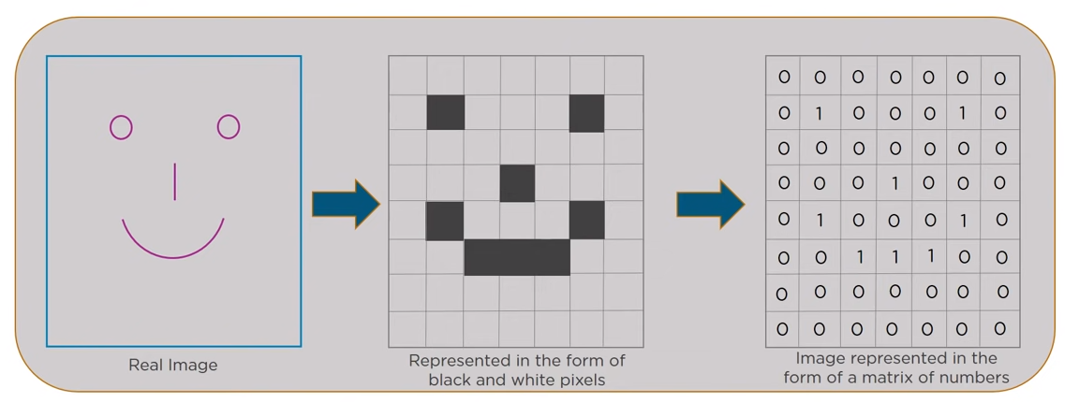
How CNN recognize Images?

Slide 20
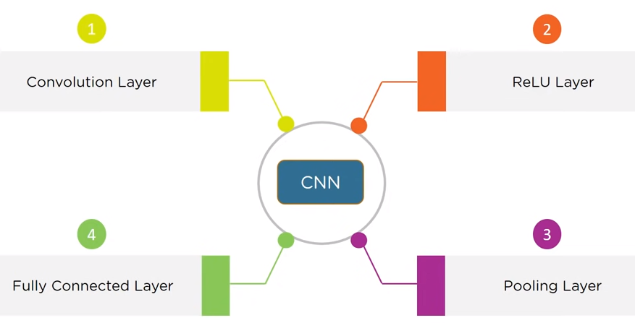
Layers of CNN

Slide 21
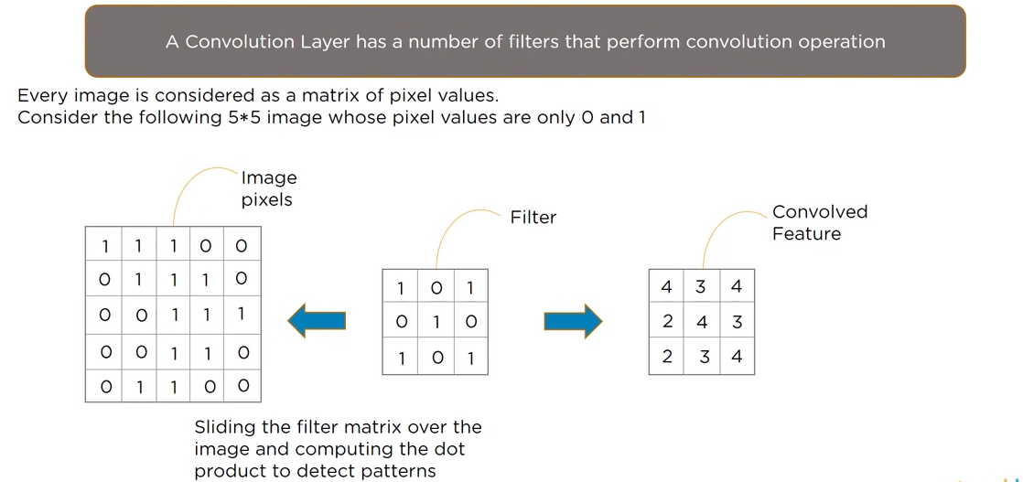
Convolution Layer

Slide 22
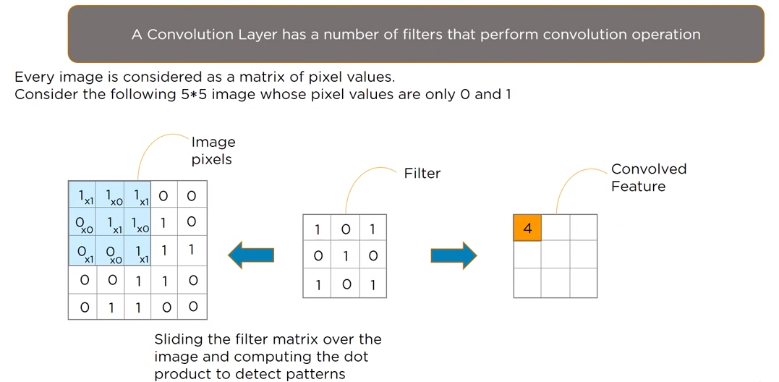
Convolution Layer(2)

Slide 23
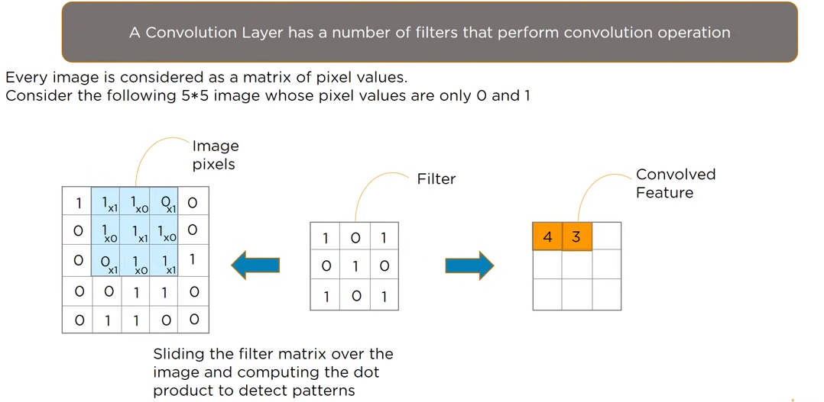
Convolution Layer(3)

Slide 24
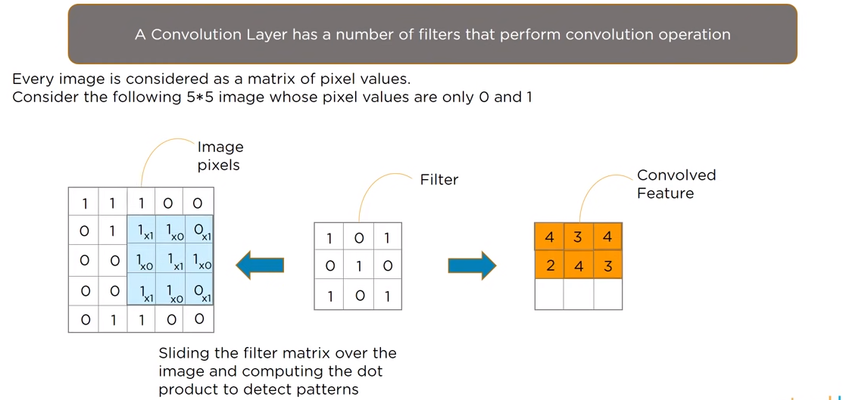
Convolution Layer (4)

Slide 25
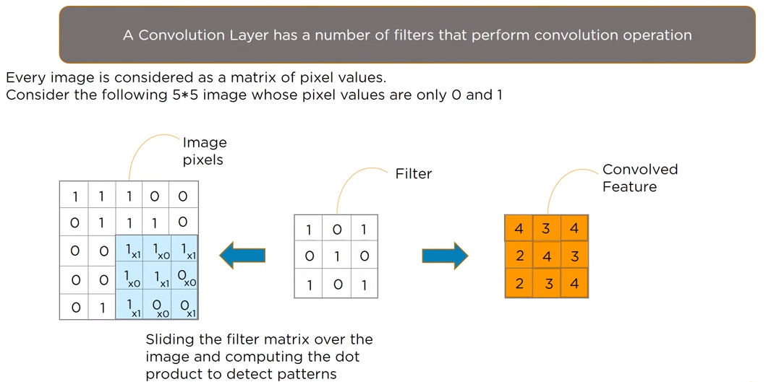
Convolution Layer (5)

Slide 26
Without Zero Padding
Input: n X n
Filter size: f X f
Output: (n-f+1) X (n-f+1)

Slide 27
Two disadvantages
There are primarily two disadvantages here:
Every time we apply a convolutional operation, the size of the image shrinks.
Pixels present in the corner of the image are used only a few number of times during convolution as compared to the central pixels. Hence, we do not focus too much on the corners since that can lead to information loss

Slide 28
Input: n X n
Padding: p
Filter size: f X f
Output: (n+2p-f+1) X (n+2p-f+1)
There are two common choices for padding:
Valid: It means no padding. If we are using valid padding, the output will be (n-f+1) X (n-f+1)
Same: Here, we apply padding so that the output size is the same as the input size, i.e., n+2p-f+1 = n So, p = (f-1)/2

Slide 29
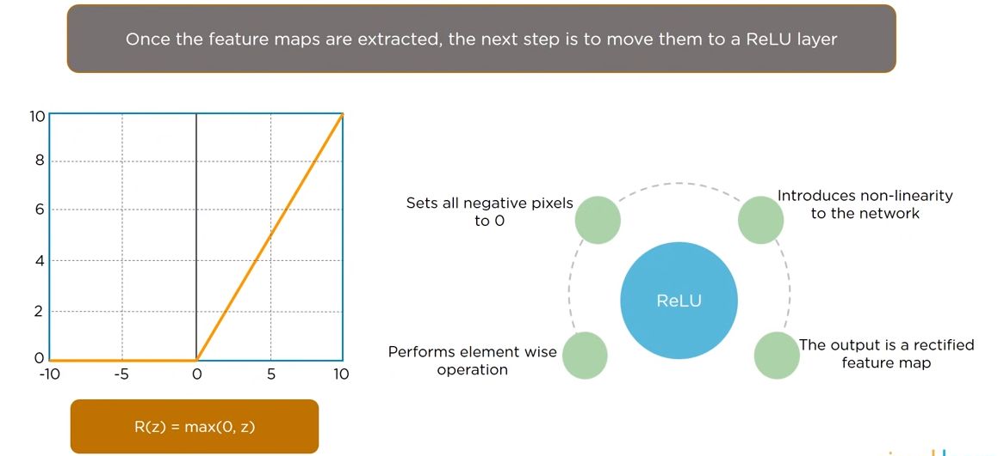
Rectified Linear Unit (ReLU) Layer

Slide 30
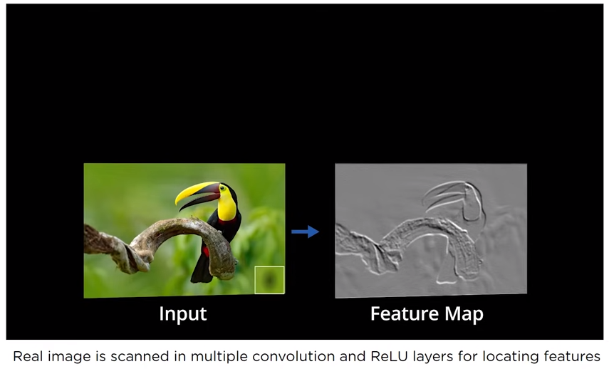
ReLU Layer (2)

Slide 31
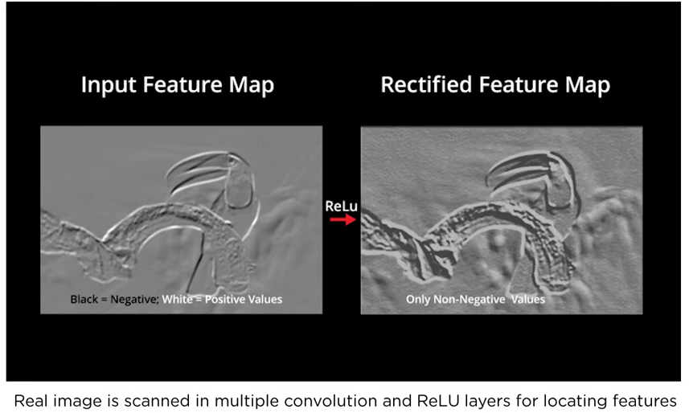
ReLU Layer (3)

Slide 32
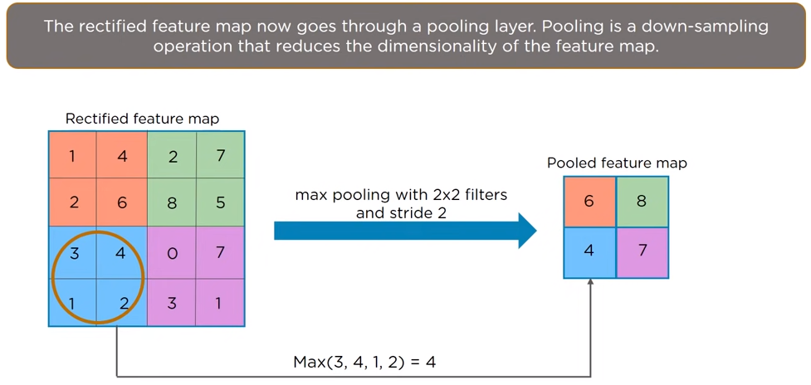
Pooling Layer

Slide 33
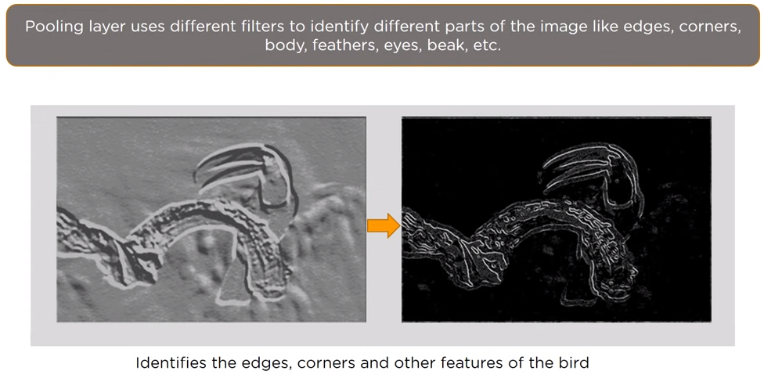
Pooling Layer (2)

Slide 34
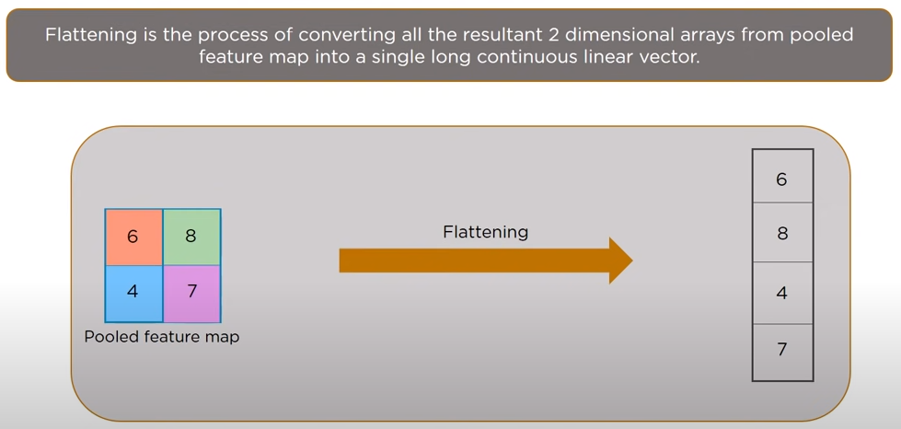
Flattening

Slide 35
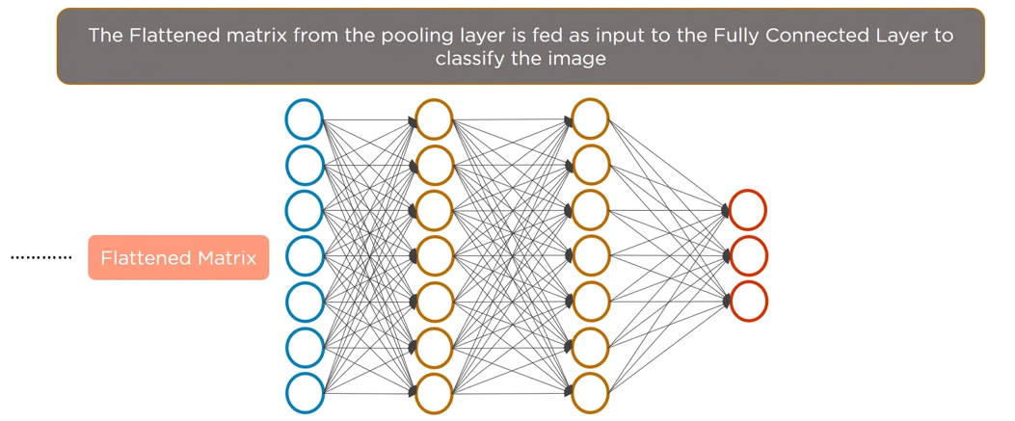
Fully Connected Layer

Slide 36
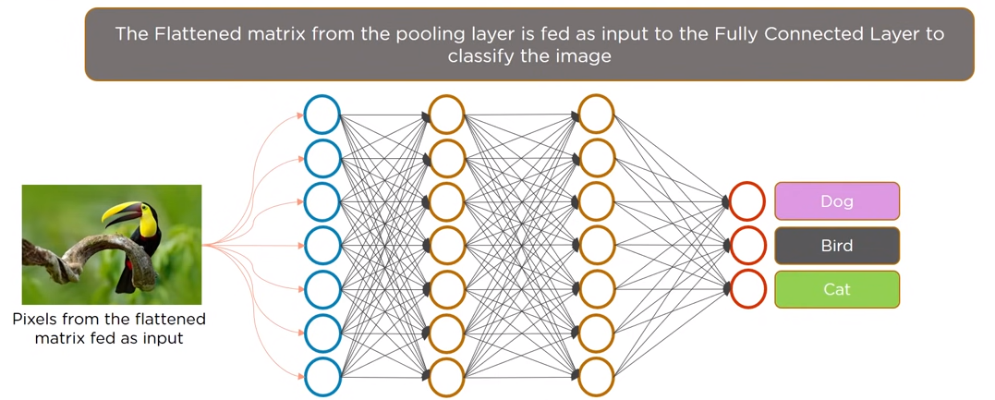
Fully Connected Layer (2)

Slide 37
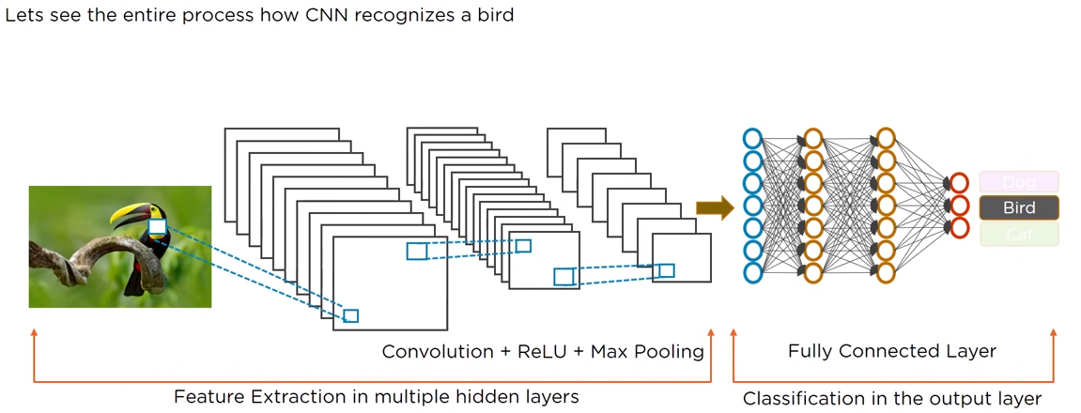
Complete CNN for Bird Recognition

Slide 38


The whole CNN
cat dog ……
Convolution
Max Pooling
Can repeat many times
Fully Connected Feedforward network
Convolution
Max Pooling
Flattened

Slide 39
https://medium.com/@draj0718/zero-padding-in-convolutional-neural-networks-bf1410438e99
https://colab.research.google.com/drive/1HBMLctcBnhvV6Rj62Zc8eAXERQw54l2H?usp=sharing#scrollTo=mL_dQ3K0M-ZL

Slide 40
A CNN compresses a fully connected network in two ways:
Reducing number of connections
Shared weights on the edges
Max pooling further reduces the complexity

Slide 41
Max Pooling
New image
but smaller
1 | 0 | 0 | 0 | 0 | 1
0 | 1 | 0 | 0 | 1 | 0
0 | 0 | 1 | 1 | 0 | 0
1 | 0 | 0 | 0 | 1 | 0
0 | 1 | 0 | 0 | 1 | 0
0 | 0 | 1 | 0 | 1 | 0
Conv
3
0
-1
1
Max
Pooling
3
1
0
3
2 x 2 image
6 x 6 image
Each filter
is a channel

Slide 42
The whole CNN
3
0
-1
1
Convolution
3
1
0
3
Max Pooling
Can repeat many times
A new image
Convolution
Smaller than the original image
The number of channels is the number of filters
Max Pooling

Slide 43
The whole CNN
cat dog ……
Convolution
Max Pooling
Fully Connected Feedforward network
A new image
Convolution
Max Pooling
Flattened
A new image

Slide 44
Flattening
3
0
1
3
0
-1
1
3
3
1
-1
0
3
Flattened
1
Fully Connected Feedforward network
0
3

Slide 45
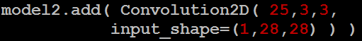
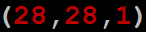
CNN in Keras
Only modified the network structure and input format (vector -> 3-D tensor)
input
Convolution
1 | -1 | -1
-1 | 1 | -1
-1 | -1 | 1
-1 | 1 | -1
-1 | 1 | -1
-1 | 1 | -1
There are 25 3x3 filters.
……
Max Pooling
Input_shape = ( 28 , 28 , 1)
28 x 28 pixels
1: black/white, 3: RGB
Convolution
3
-1
3
Max Pooling
-3
1

Slide 46
CNN in Keras
Only modified the network structure and input format (vector -> 3-D array)
Input
1 x 28 x 28
Convolution
How many parameters for each filter?
9
25 x 26 x 26
Max Pooling
25 x 13 x 13
Convolution
How many parameters
for each filter?
225=
25x9
50 x 11 x 11
Max Pooling
50 x 5 x 5

Slide 47
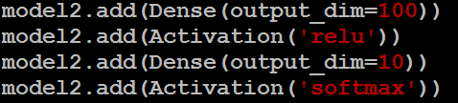
CNN in Keras
Only modified the network structure and input format (vector -> 3-D array)
Input
1 x 28 x 28
Output
Convolution
25 x 26 x 26
Fully connected feedforward network
Max Pooling
25 x 13 x 13
Convolution
50 x 11 x 11
Max Pooling
1250
50 x 5 x 5
Flattened

Slide 48
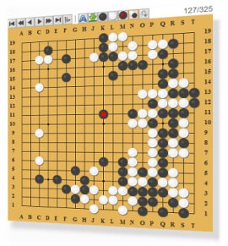
AlphaGo
Neural
Network
Next move
(19 x 19 positions)
19 x 19 matrix
Fully-connected feedforward network can be used
Black: 1
white: -1
none: 0
But CNN performs much better

